Slide 1
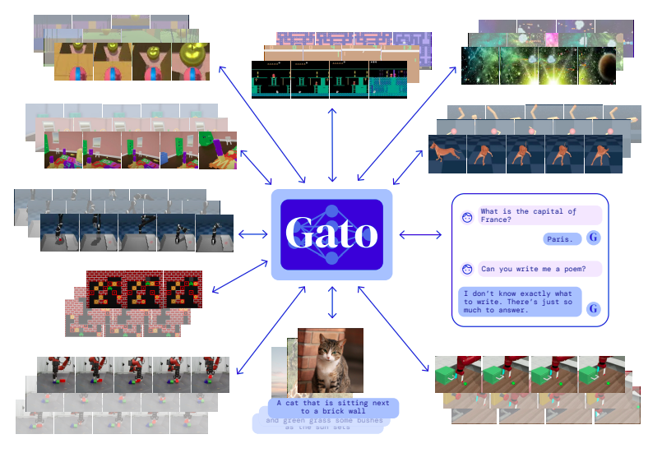
A Generalist Agent
Presentation by TJ LaGrow
TReNDS Center MLBBQ
9/16/2022
Reed, Scott, et al. "A generalist agent." arXiv preprint arXiv:2205.06175 (2022).
Web posting: https://www.deepmind.com/publications/a-generalist-agent
Notes:
https://www.youtube.com/watch?v=wSQJZHfAg18&ab_channel=EdanMeyer

Slide 2
Overview
Go over the general concept of the model
Architecture and comparable size
Performance and positive/negative transfer
Scale Considerations
Ablation study
Steps forward

Slide 3
Overview
Go over the general concept of the model
Architecture and comparable size
Performance and positive/negative transfer
Scale Considerations
Ablation study
Steps forward
Is this helping or hurting the argument of AGI? Should we consider this more ‘weak’ or ‘narrow’ AI?

Slide 4
GATO Overview
Notes:
Language Models (Talk/write)
Vision Tasks (see/recognize)
Physical World Tasks (move/manipulate)

Slide 5
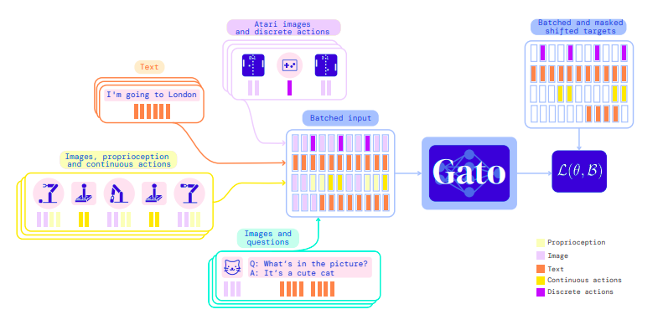
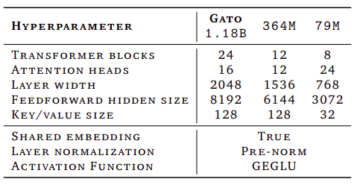
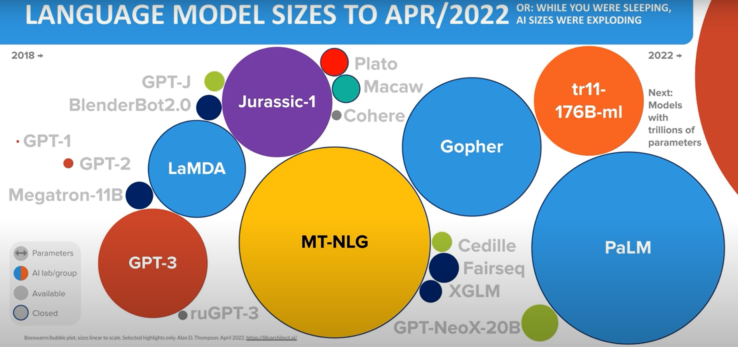
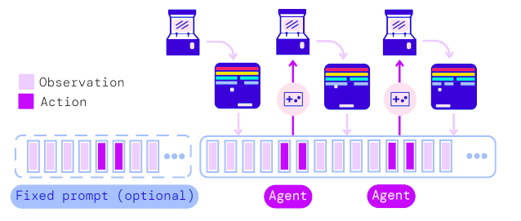
Architecture
Notes:
RTX 3090

Slide 6
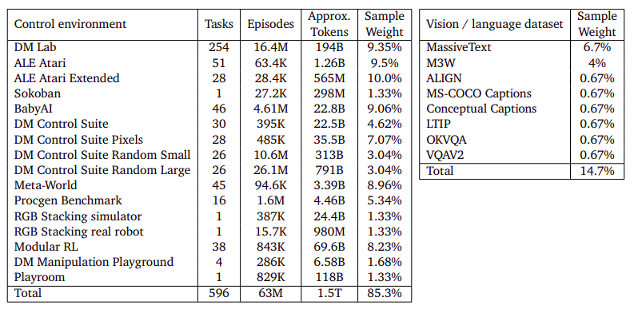
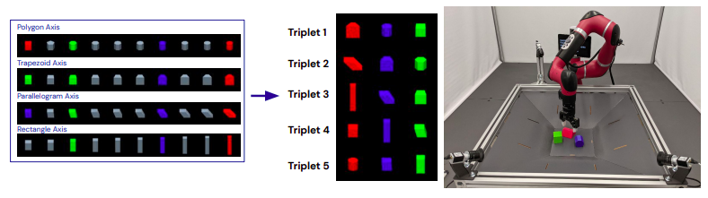
Tasks

Slide 7
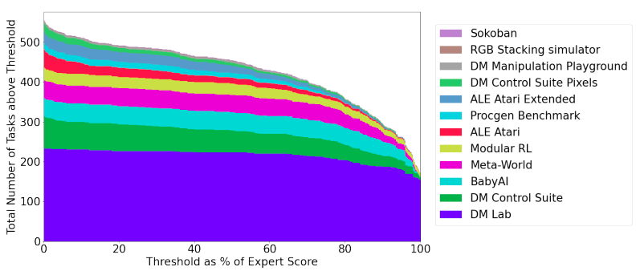
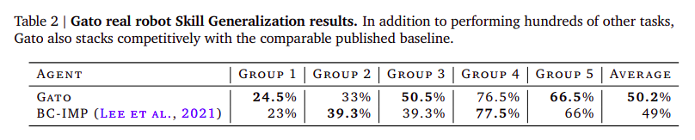
GATO

Slide 8
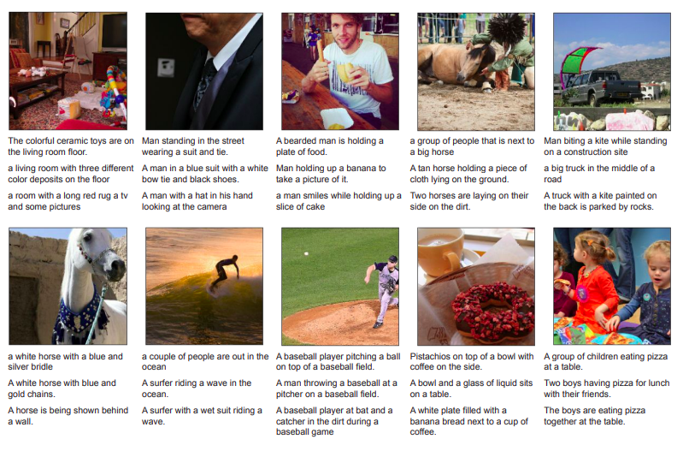
Example for Generating Image Labels

Slide 9
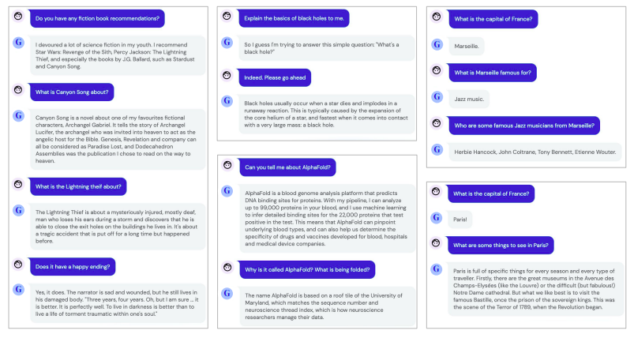
Example for Textbot Conversation

Slide 10
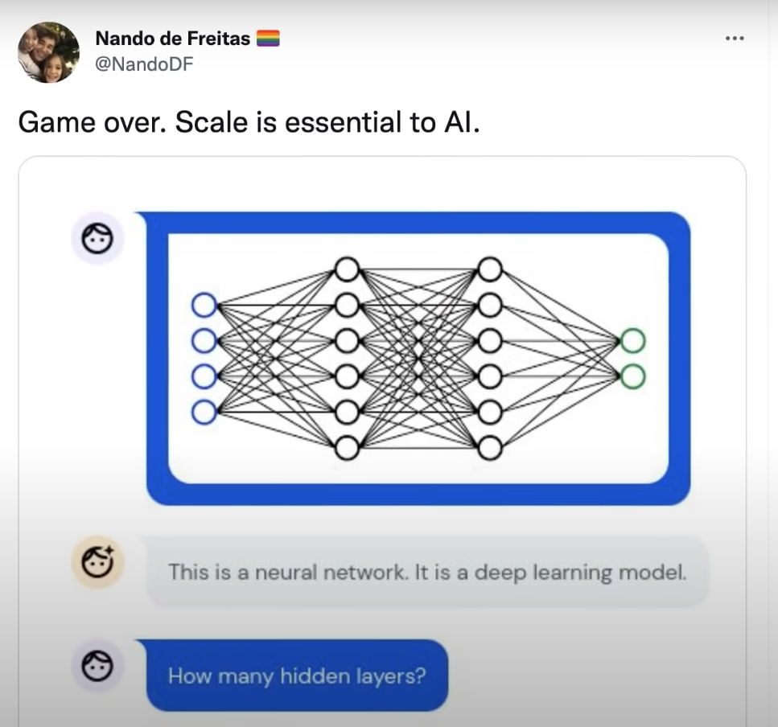
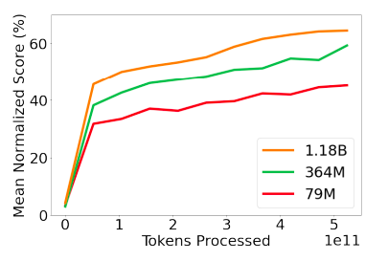
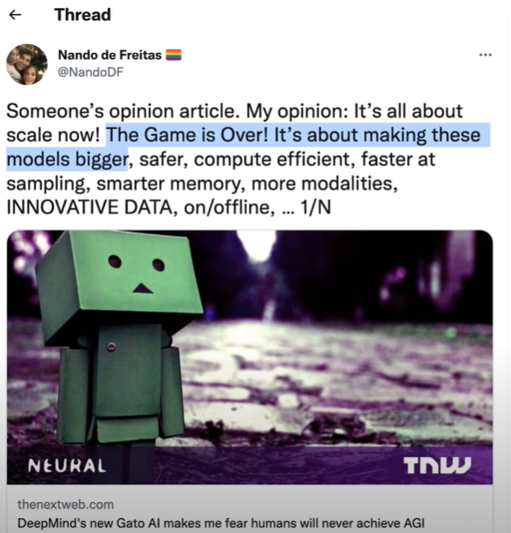
Scale

Slide 11
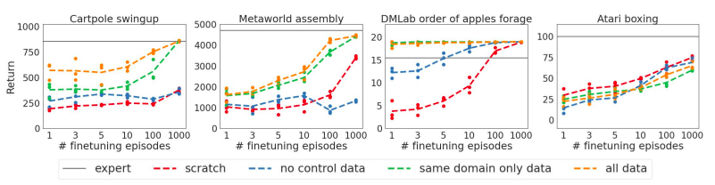
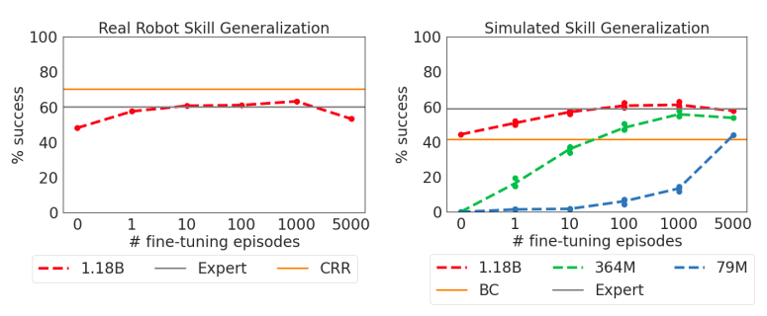
GATO

Slide 12
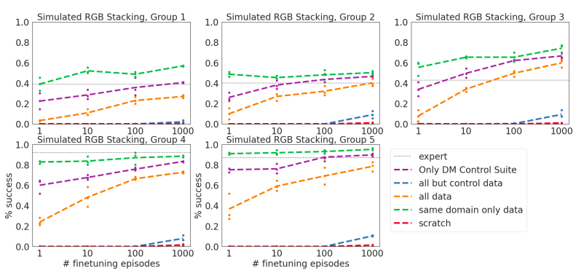
GATO

Slide 13
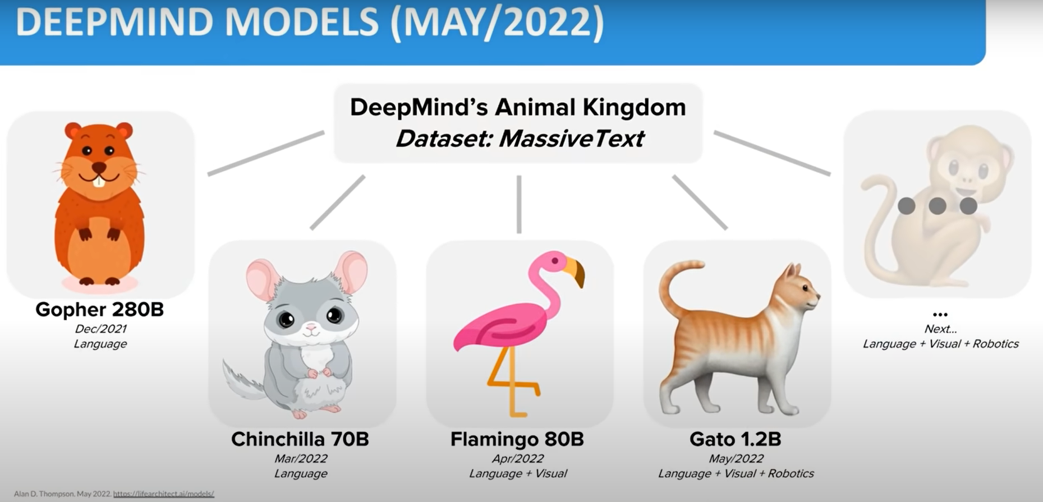
GATO

Slide 14
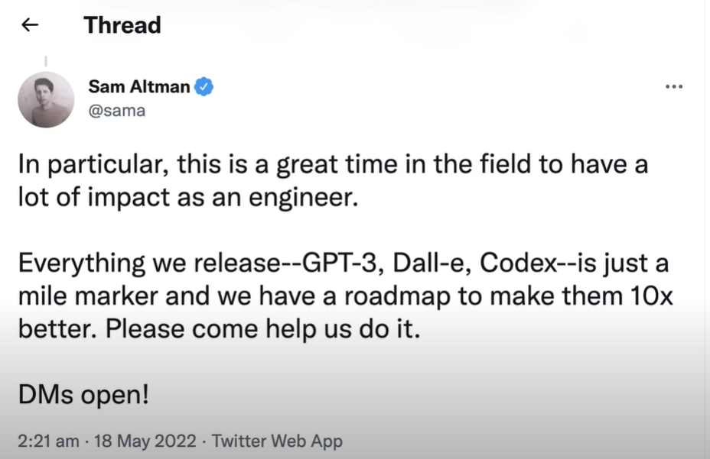
GATO

Slide 15
Thank you!

Slide 16
Appendix

Slide 17
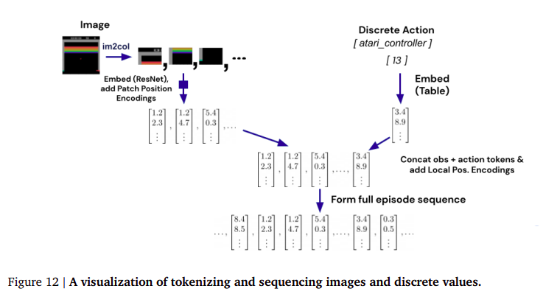
GATO

Slide 18
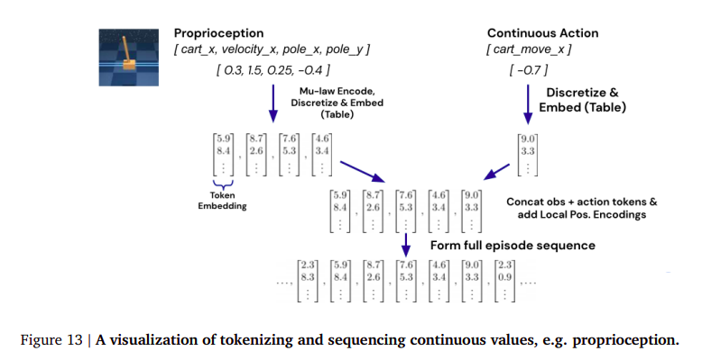
GATO

Slide 19
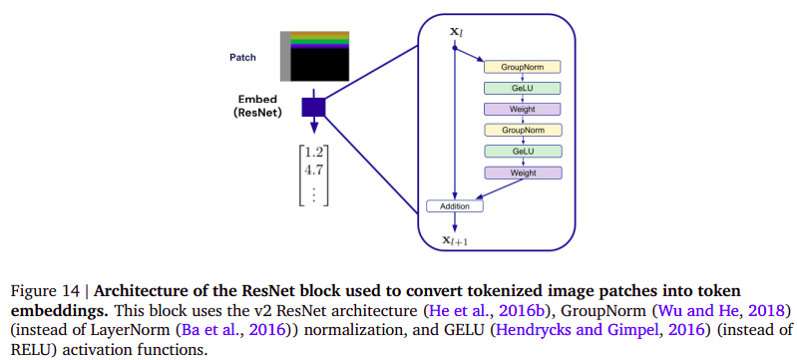
GATO

